Slide 1


Excel coffee shop sales project
By shivani nare

Slide 2
Project overview
The project overview is all about coffee shop sales taken from Kaggle.com.
Which contains 149k rows and 11 columns .
The column consist of many parameters such as transaction id,transaction date ,transaction quantity ,store id , store location , product id , unit price , product detail,product type ,product category etc.
The Coffee Shop Sales Analysis project explores customer purchasing patterns, peak sales hours, and best-selling products. It leverages data analytics to optimize pricing, improve inventory management, and boost profitability. Using visualization tools, the project identifies trends and key insights to enhance business strategies. This data-driven approach helps coffee shop owners make informed decisions for sustainable growth.

Slide 3
Problem statements
Which store location has the highest number of transaction
How many of each product type were sold
Which product detail appears most frequently in transaction
What is total number of transaction per day
What is the total revenue generate per store
Which product type bring in the most revenue
Compare revenue by product type across different stores
What is the revenue trend over the month
What is the daily trend of transaction in January 2023
What is the total transaction quantity by date

Slide 4
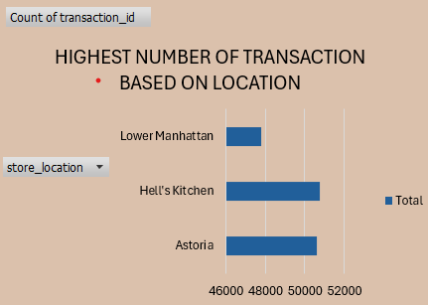
HIGHEST NUMBER OF TRANSACTION

Slide 5
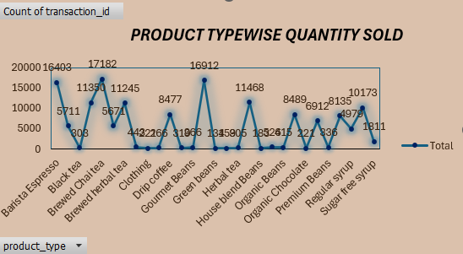
PRODUCT TYPEWISE QUANTITY SOLD

Slide 6
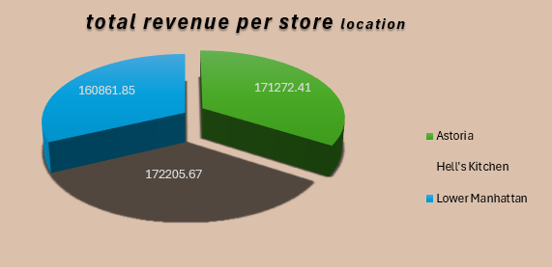
TOTAL REVENUE GENRATE PER STORE

Slide 7
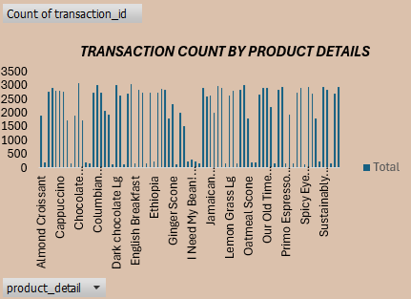
TRANSACTION COUNT BY TOTAL DETAILS

Slide 8
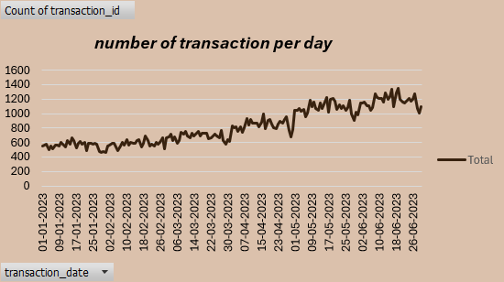
NUMBER OF TRANSACTION PER DAY

Slide 9
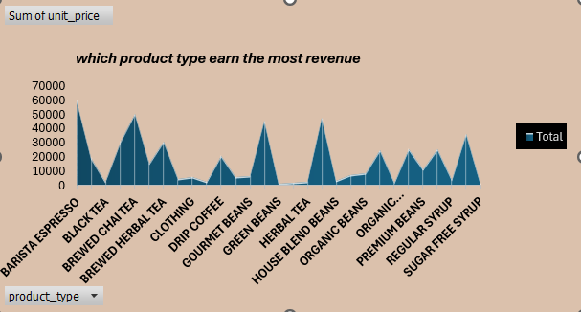
WHICH PRODUCT TYPE EARN THE MOST REVENUE

Slide 10
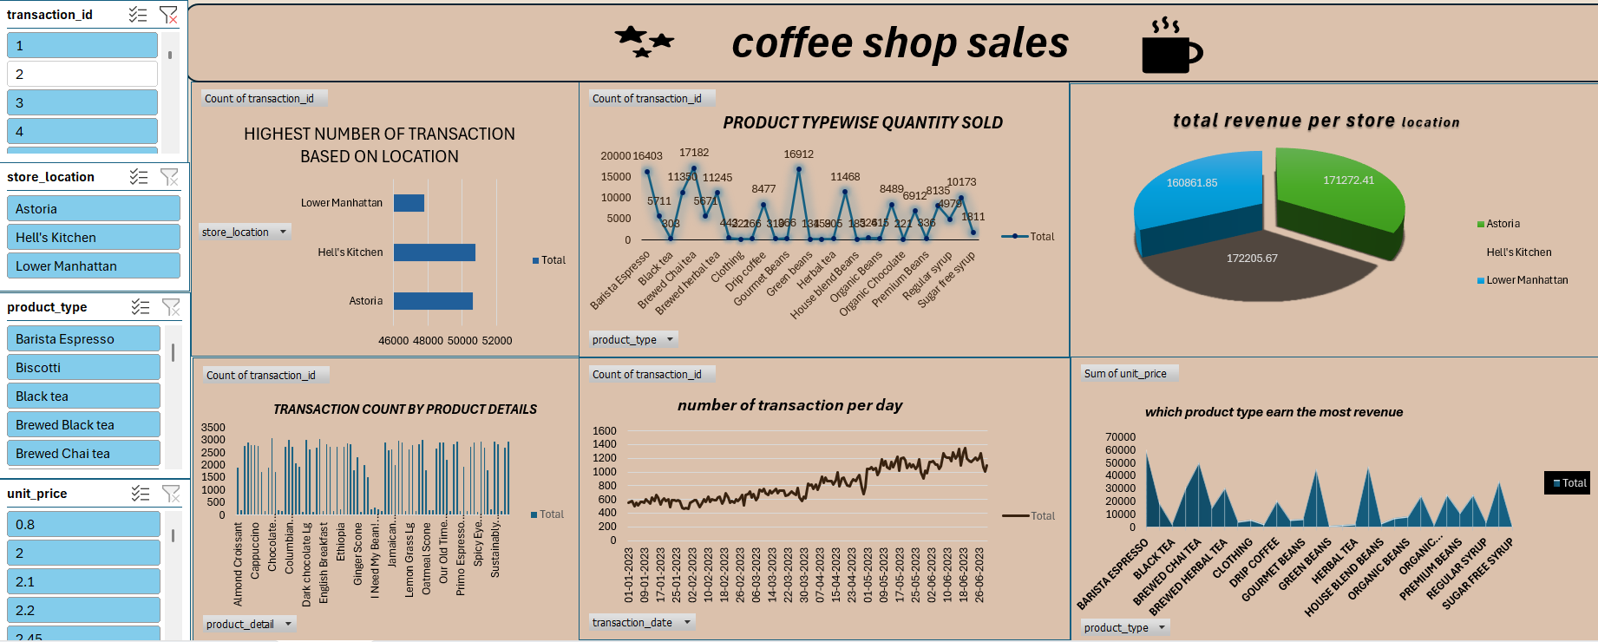
DASHBOARD OF COFFEE SHOP SALES

Slide 11
CONCLUSION
the data represents coffee sales from a store name hell’s kitchen
during jan 2023 .
all the transaction are for the same product ethiopia rg, a type of gourmet brewed coffee ,sold at fixed price
most of the customers bought just one cup at a time ,which suggests that the store had regular
regular walk in customers ,possibly office goers or daily visitor
the sales happen every day, showing that the store had CONSISTENCE BUSINESS activity.
since all the entries are for the same product and store ,it looks like this is just a small
part of the full dataset ,focusing on one product and one location only

Slide 12
PROJECT LINK

Slide 13
THANKING YOU

